Slide 1




Metallurgical Test Comparison Aerospace
Material using Additive Manufacturing
Technologies vs. Wrought Technologies
Brittany Nez
Key Acknowledgements:
John Parsey, Donald Godfrey, and Honeywell Aerospace
Gerard P. Kuiper Space Sciences
April 16, 2016

Slide 2
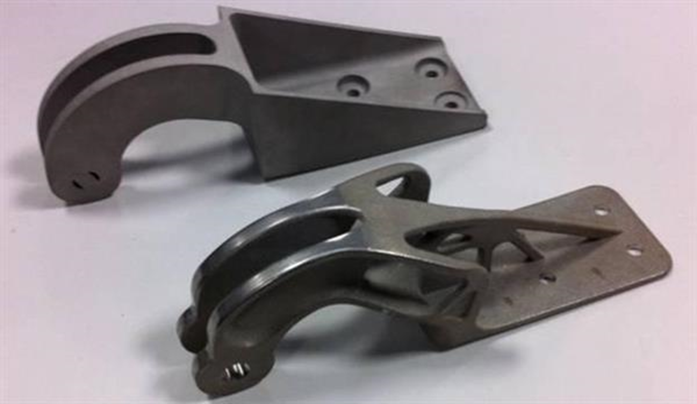
Benefits of Additive Manufacturing
Weight reduction
Ability to create complex geometries
Cost effective in low volume production
Eliminates warehousing of spare parts/ maintaining manufacturing tools

Slide 3
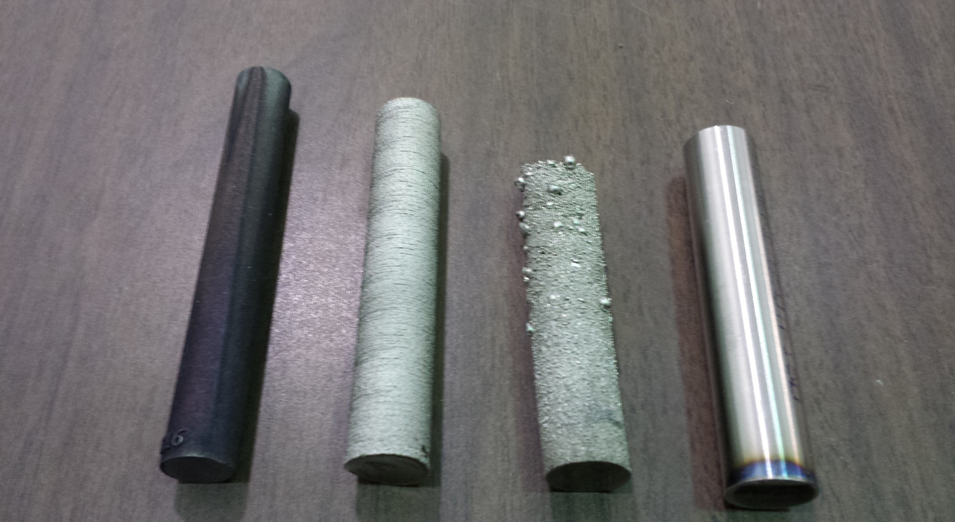
Project Specifics
Metallurgical test comparison of porosity of Inconel 718 superalloy
Manufacturing processes
  Metal Forming Processes
  Powder Bed Fusion
Deposition Factors
  Heat Treatment
  AM factors

Slide 4
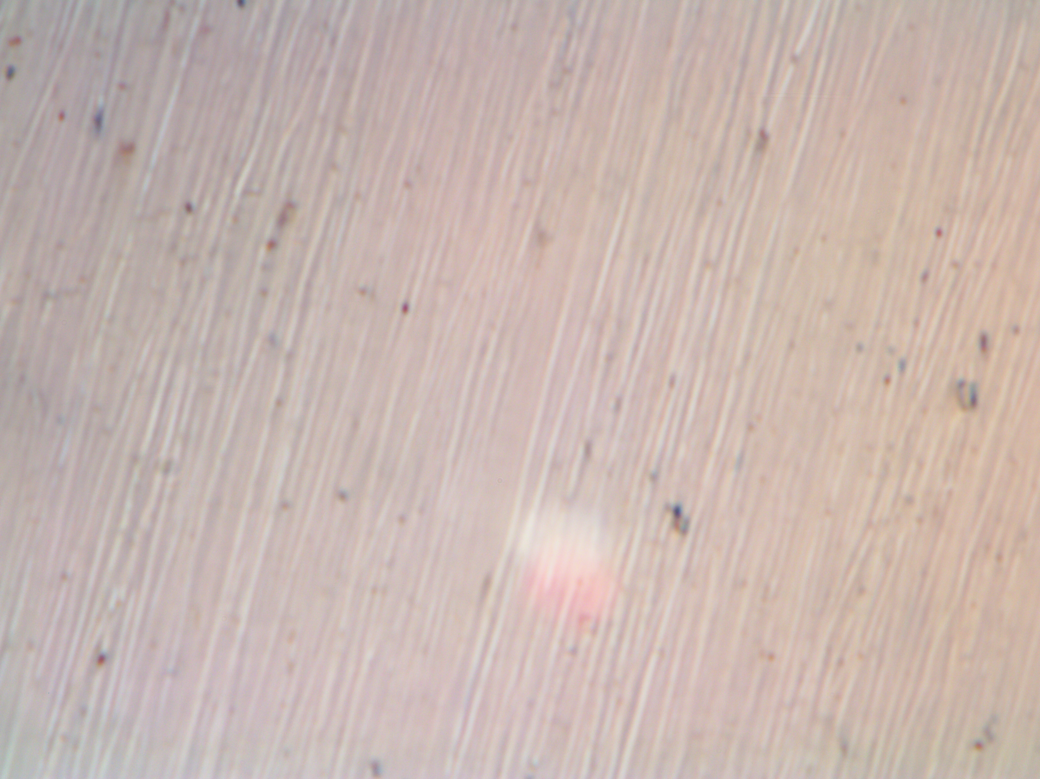
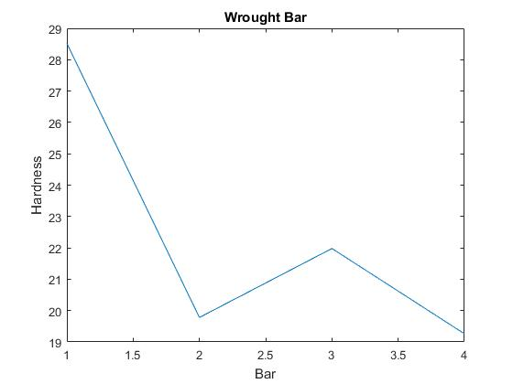
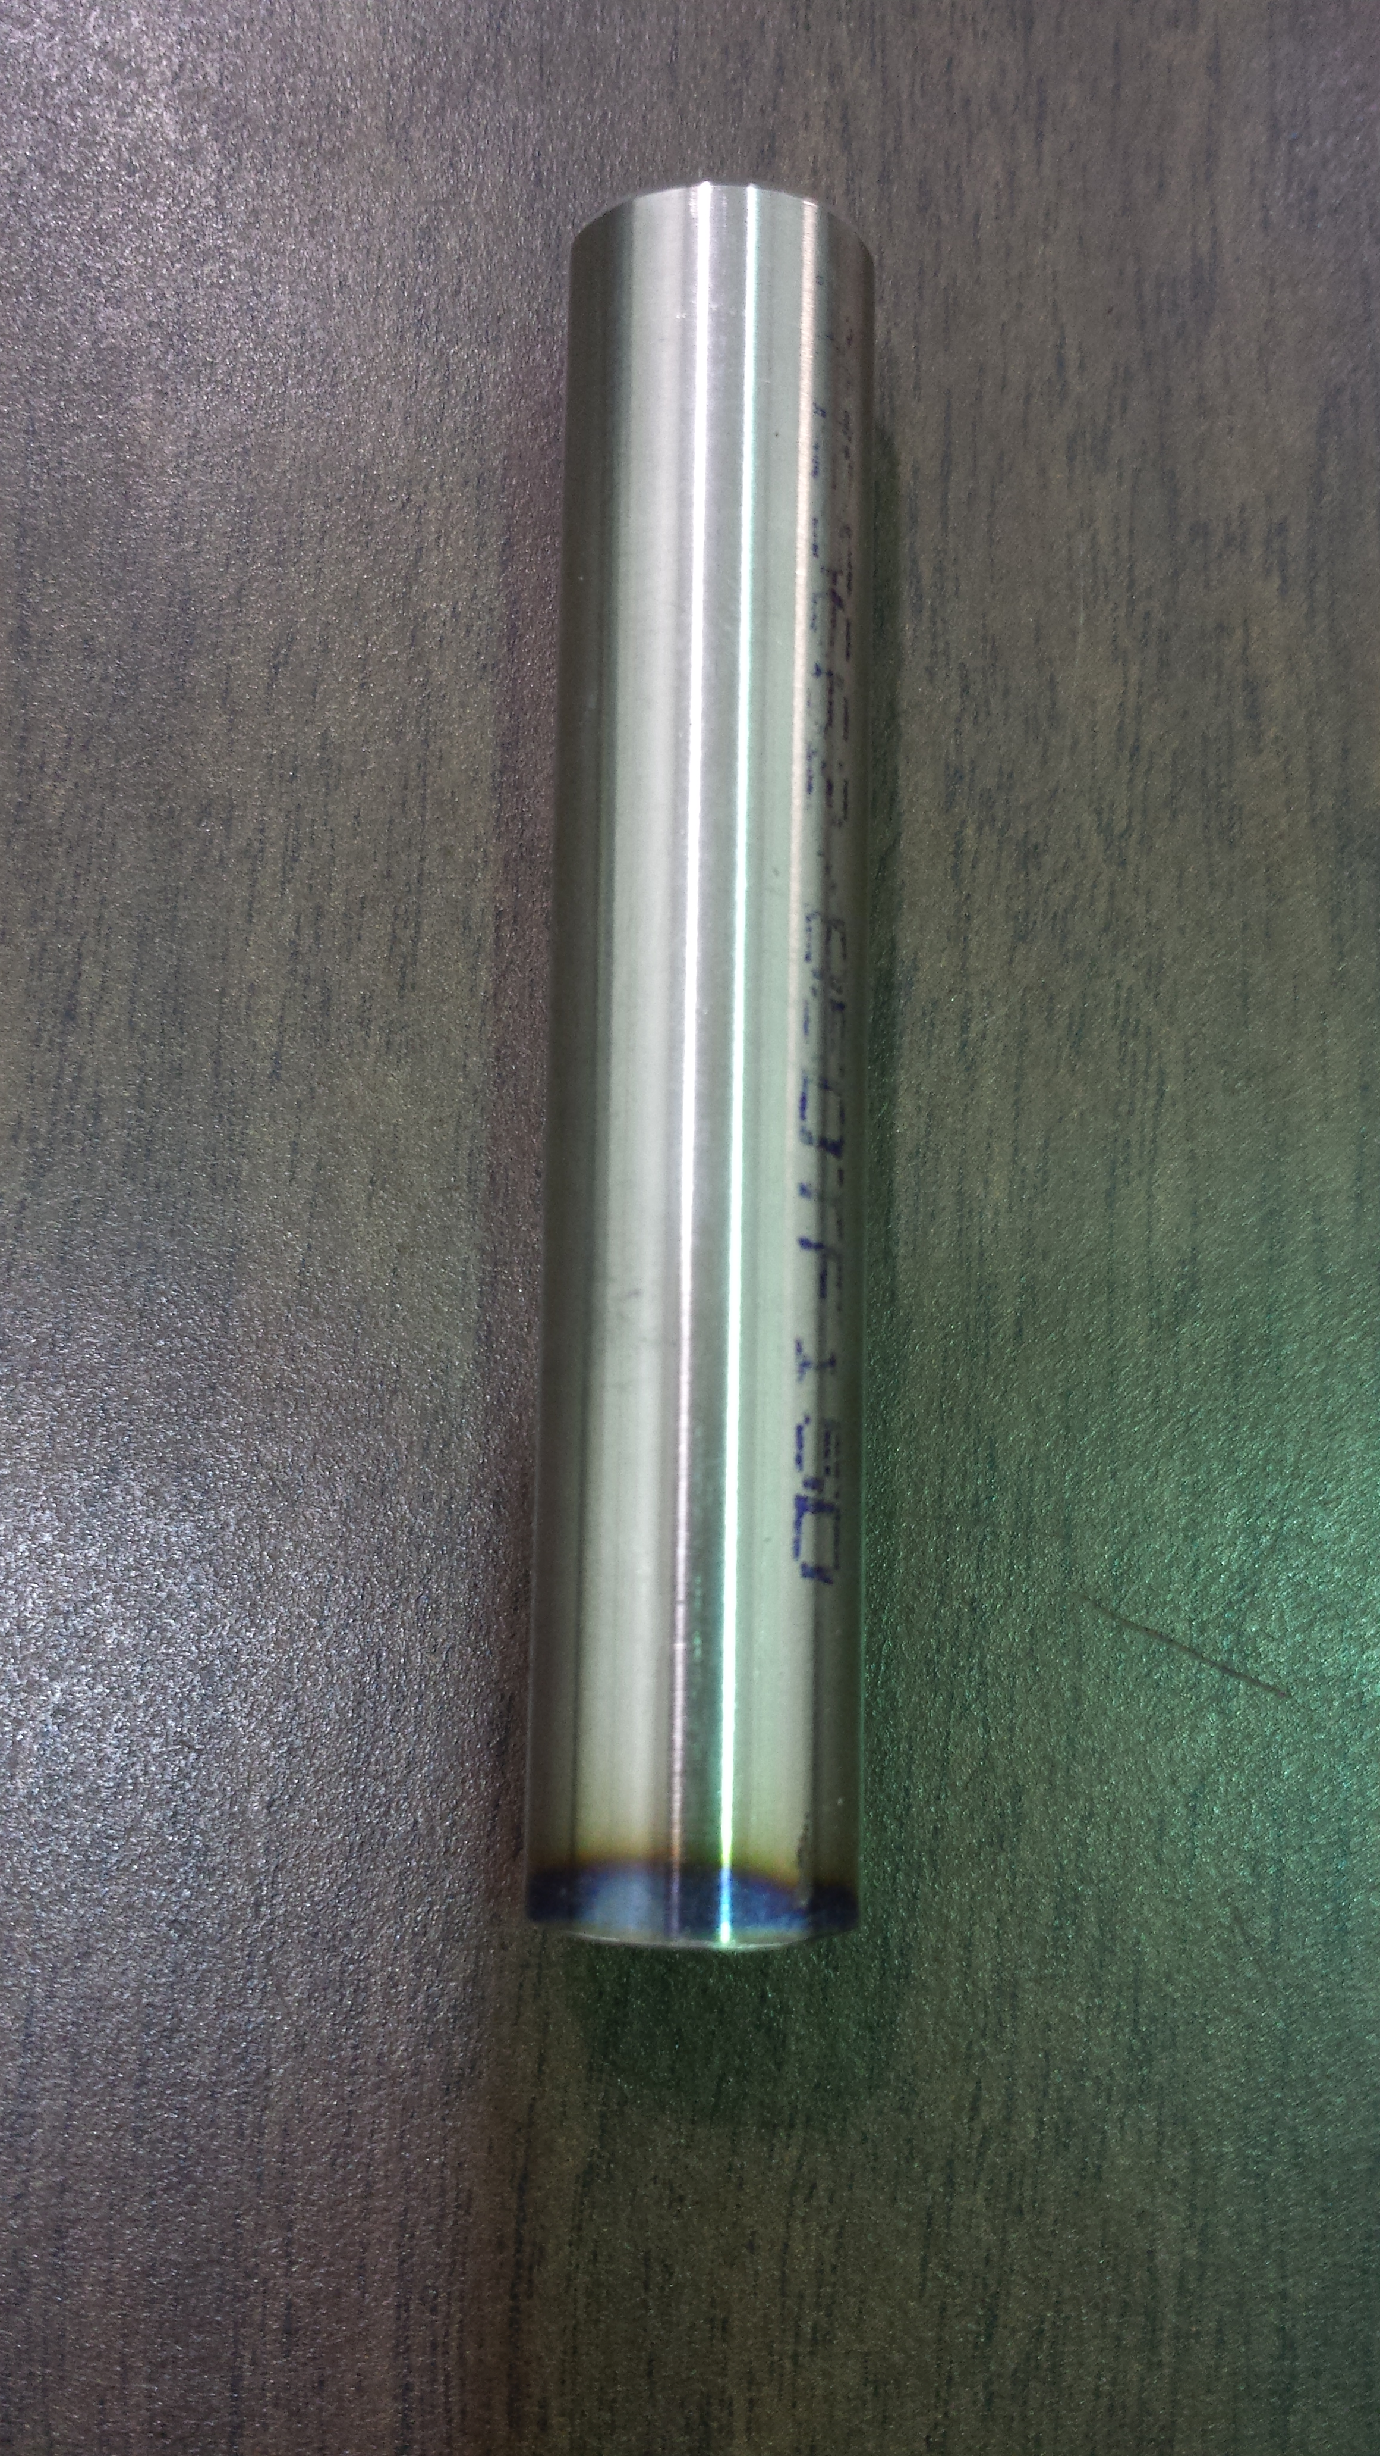
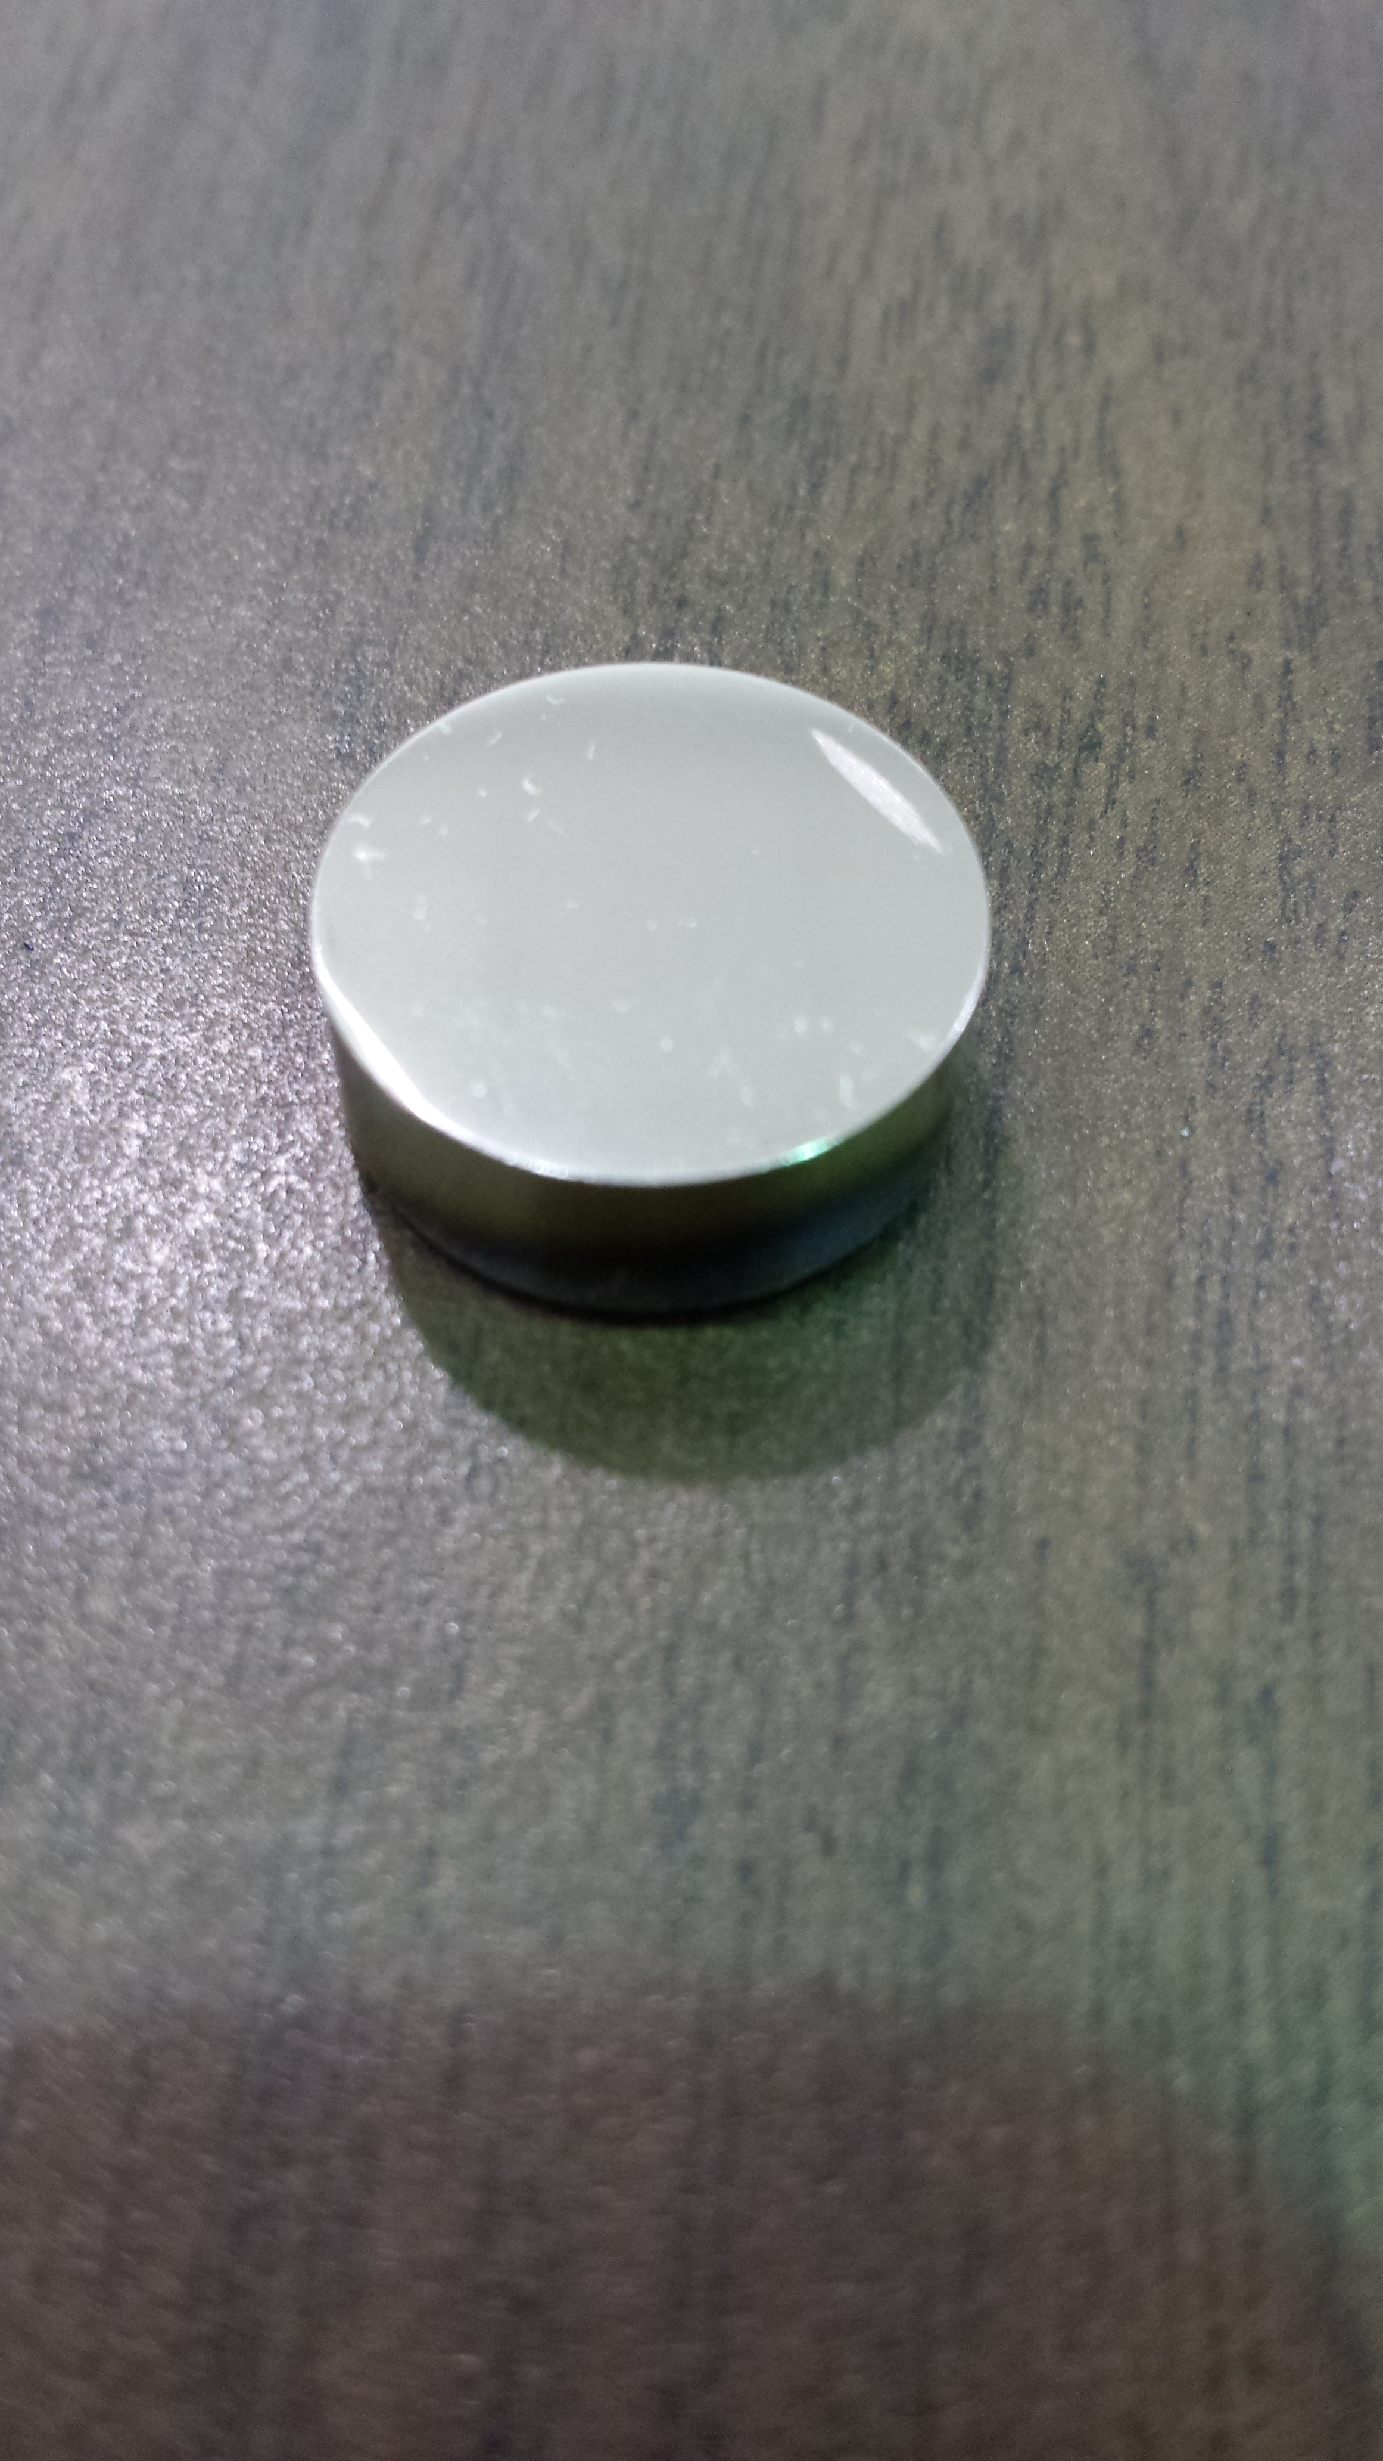
Wrought Material

Slide 5
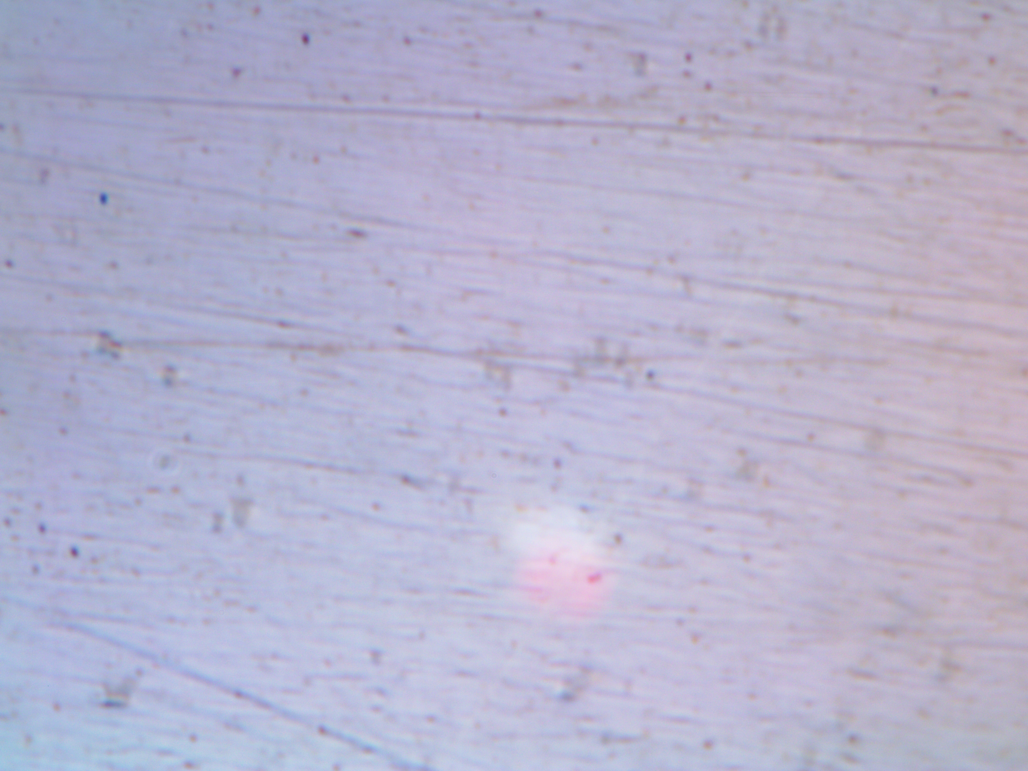
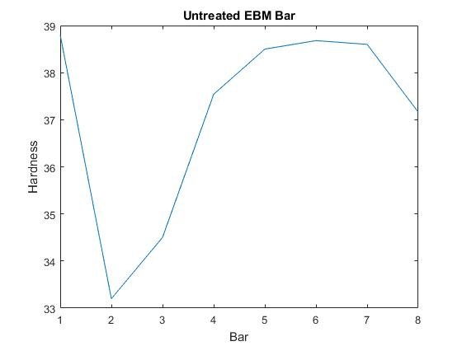
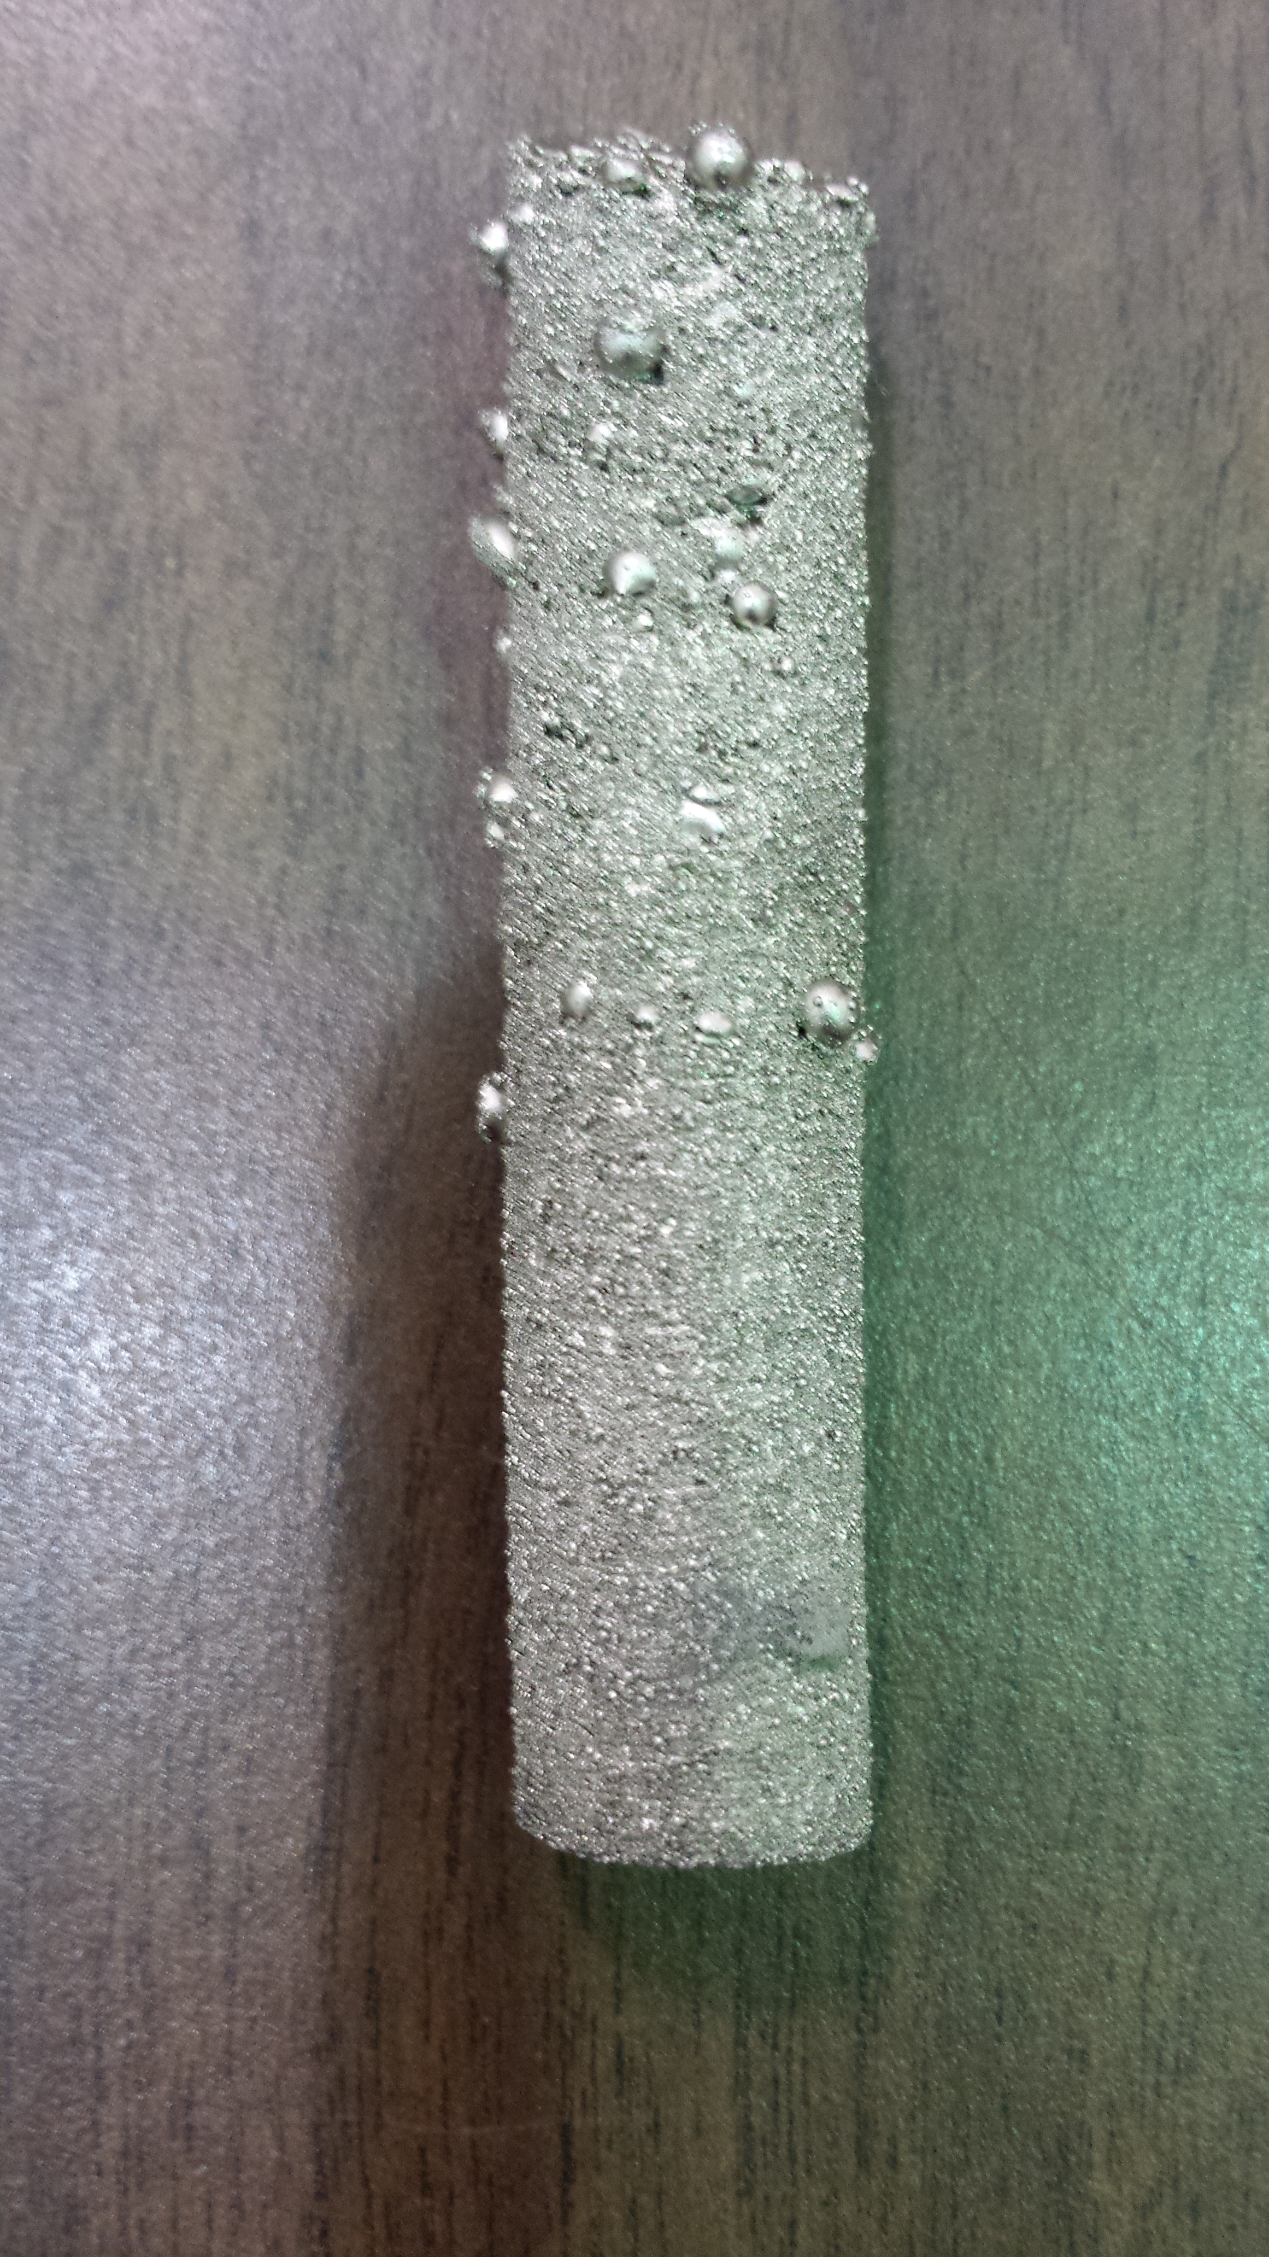
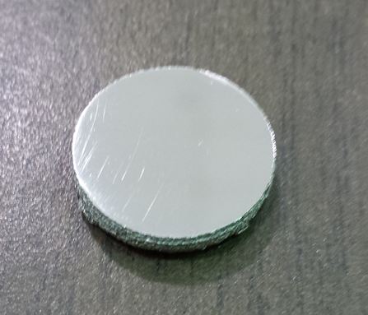
Electron Beam Melting (Untreated)

Slide 6
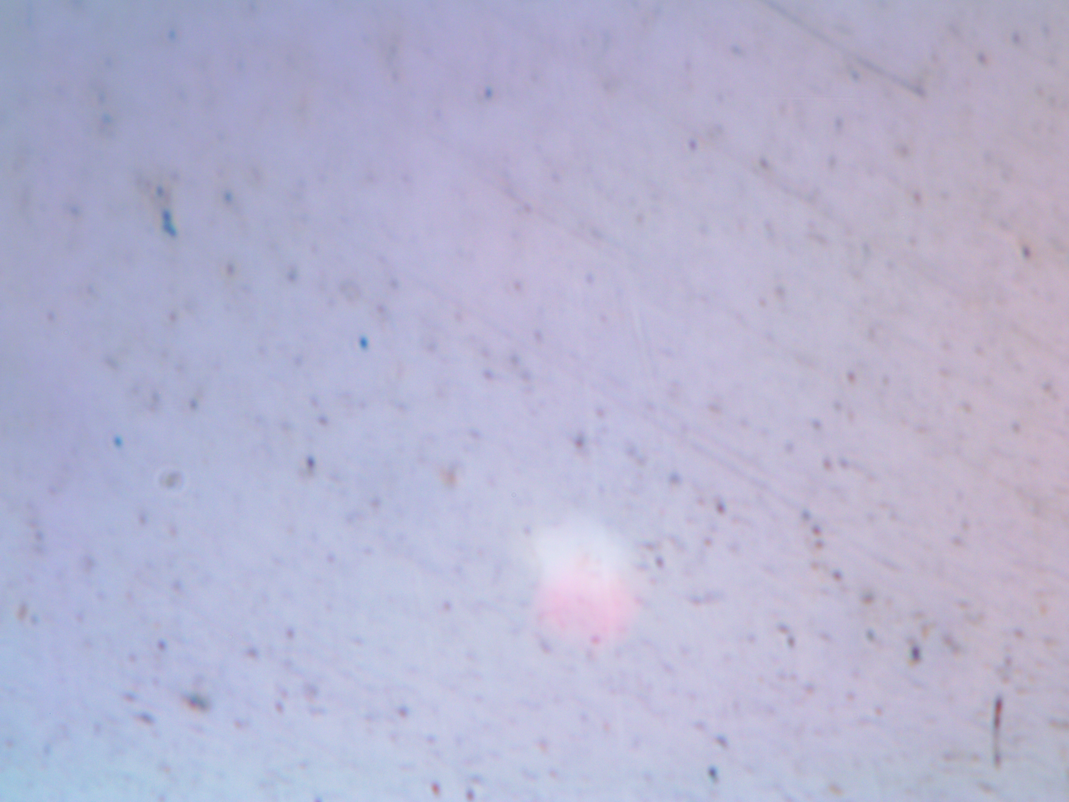
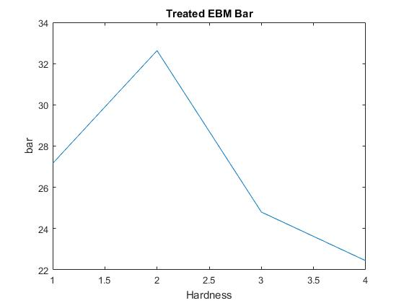
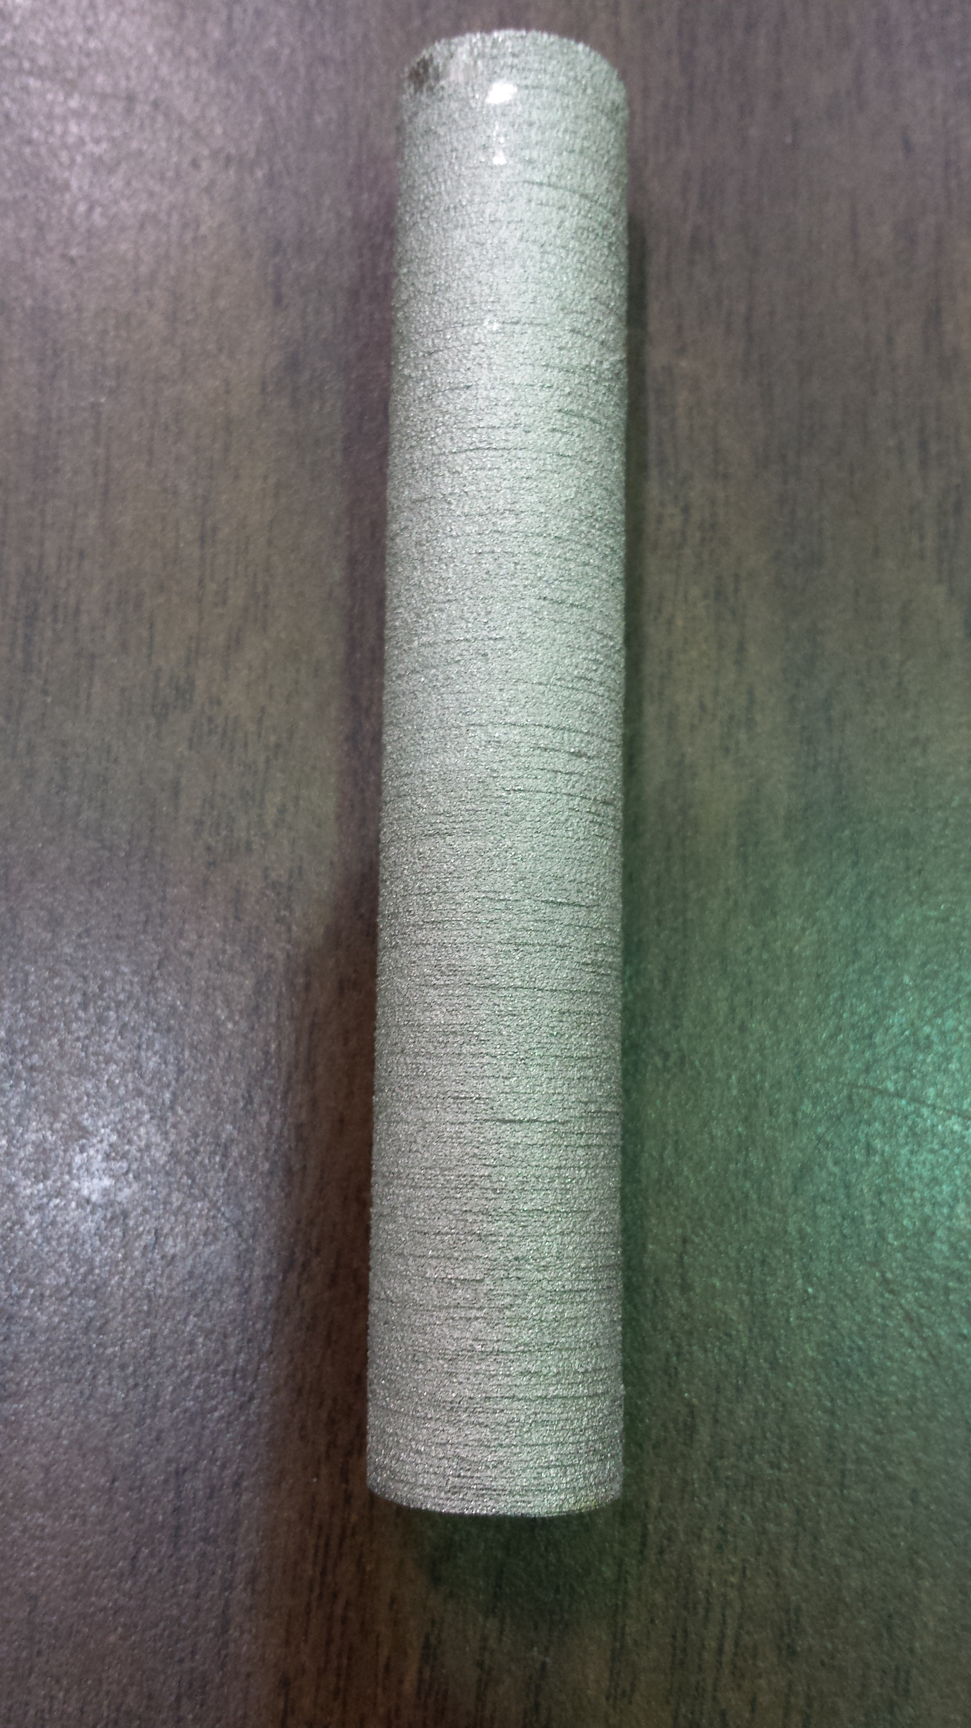
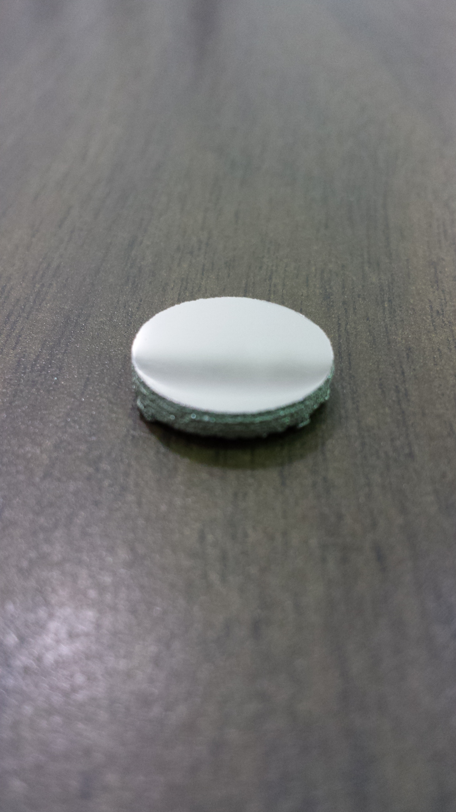
Electron Beam Melting (Treated)

Slide 7
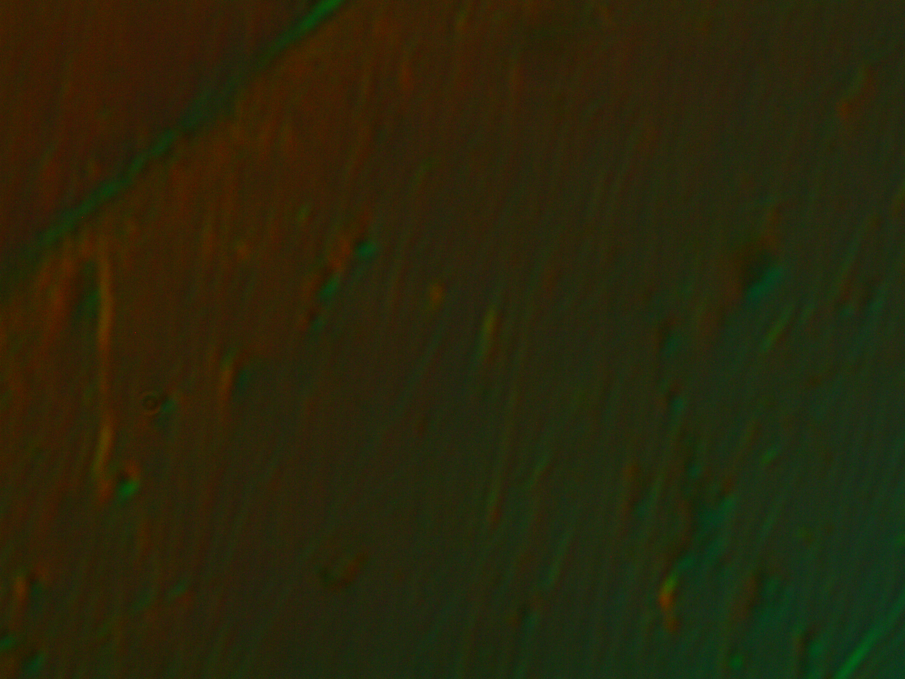
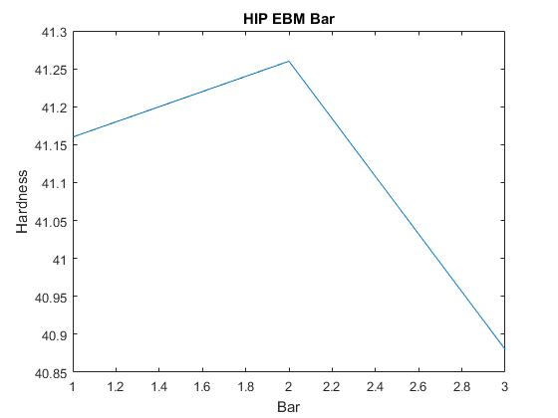
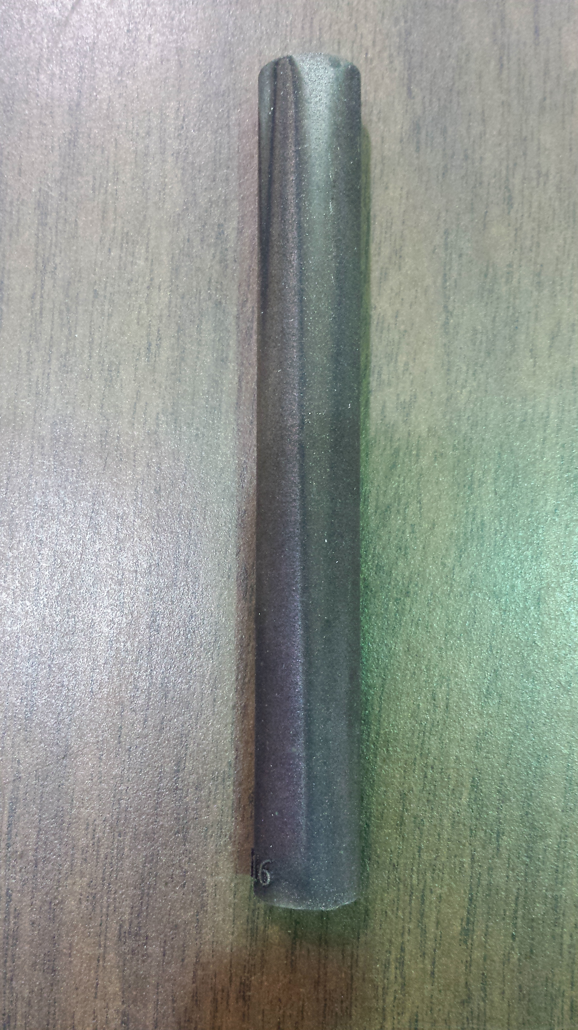
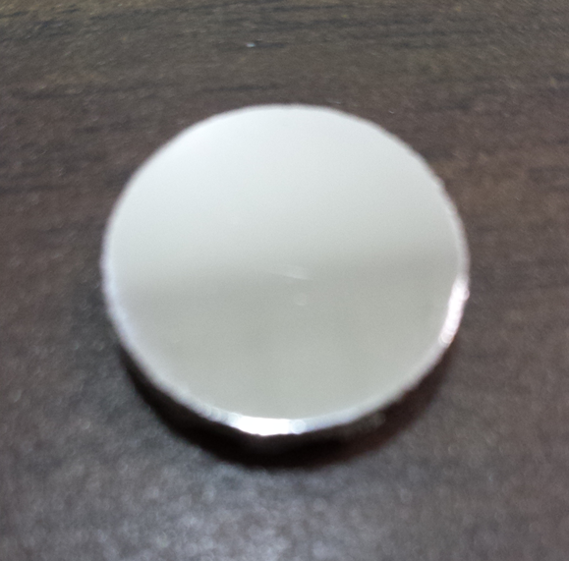
Electron Beam Melting (HIP)

Slide 8
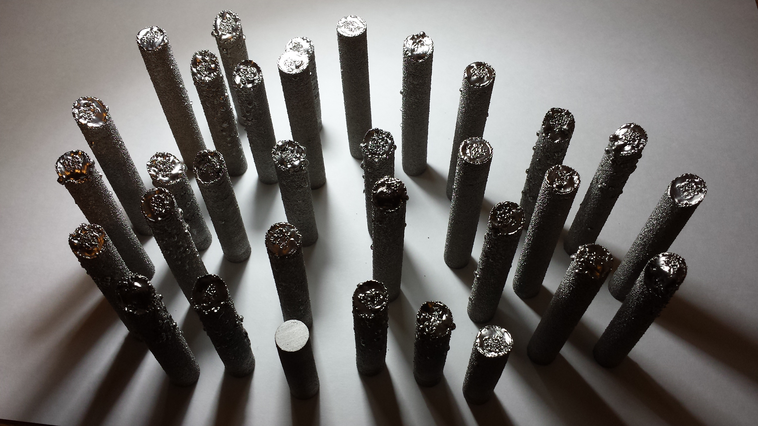
Future Endeavors
Direct metal laser sintering
Effects of AM process in microgravity environment
Thermal properties of electron beam material

Slide 9
Acknowledgements
Mentor:
  John Parsey
Honeywell Aerospace:
  Donald Godfrey
  Additive Manufacturing Team
ASU/NASA Space Grant
Machining and Manufacturing at ASU Polytechnic:
  Rhett Sweeney
  Osama Jameel
  John Dolan

